Slide 1

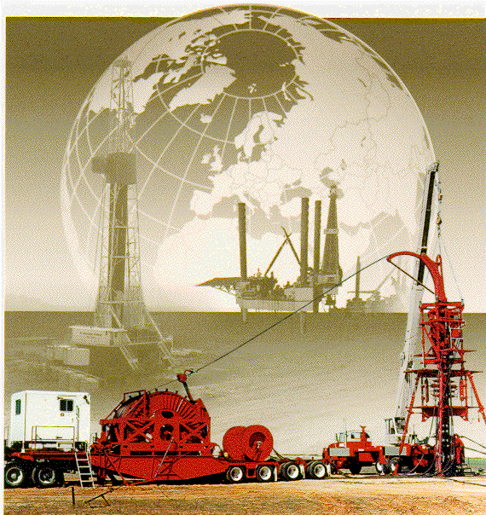
How to Change CT
GWDC well Testing Company
Lecturer：Li Xuening
2010.12

Slide 2
Factors Affecting CT Fatigue Life
OPERATIONAL FACTORS
Tubing Stresses
  Internal pressure applied to tubing while cycling
  Cycles across the gooseneck (guide arch) and reel
  Over pulls (stuck tubing)
Mechanical Damage--Stress-riser conditions
Equipment & Job Layout--Bending radii
Corrosive and Abrasive Fluids
  Reduction in wall thickness (strength)
  Stress-riser conditions
Notes:
Simulators only take into account cycles, not axial loads. That is in process.

Slide 3
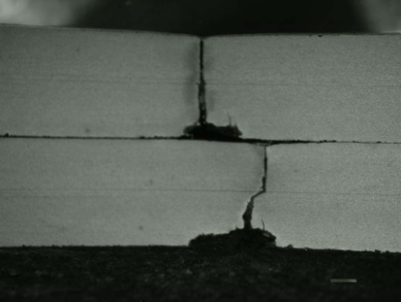
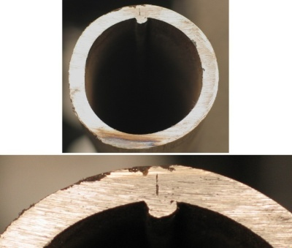
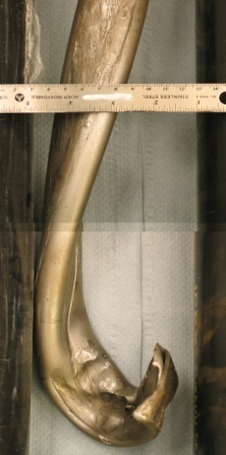
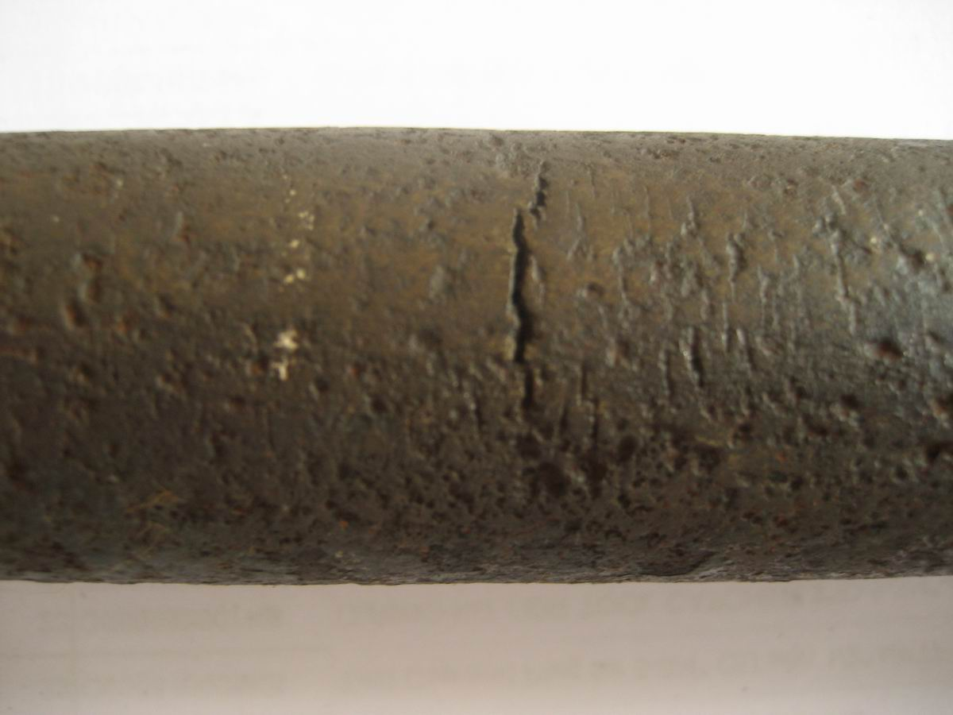
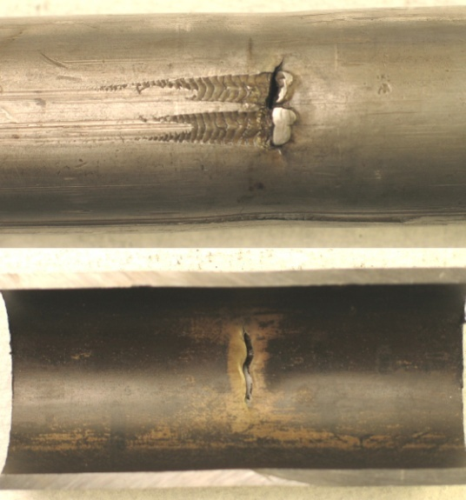
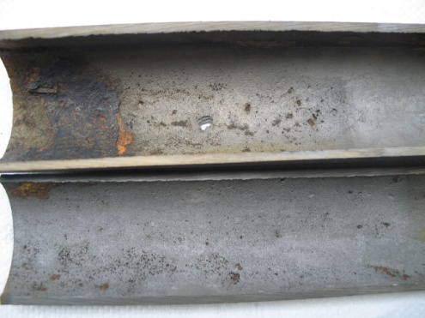
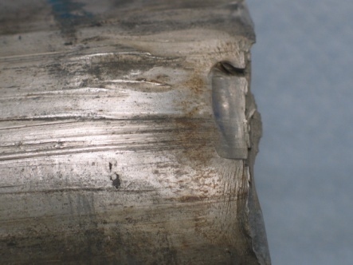
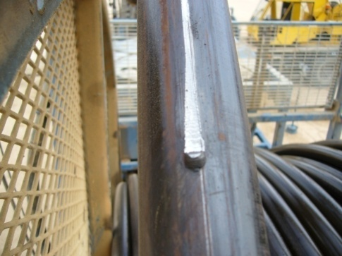
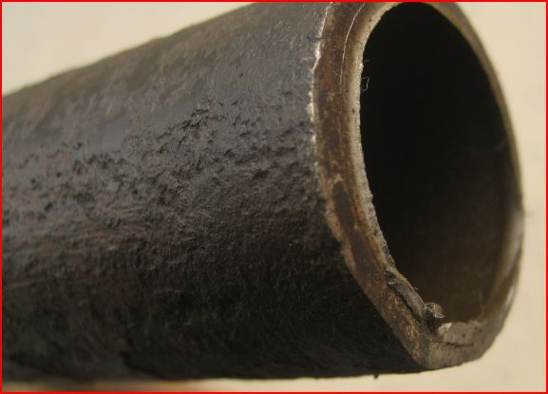
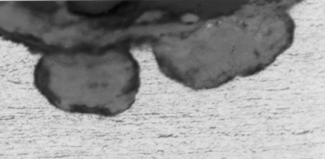
TYPICAL BREAKDOWN FOR SOURCE OF COILED TUBING FAILURES
Operator
Error
Manufacturing defect, 9%
Other Causes
17%
Corrosion-Fatigue
12%
Mechanical Damage
47%
Corrosion
24%
Pitting

Slide 4
Factors Affecting CT Fatigue Life
DERATING FACTORS FOR WELDS
Bias Weld, Gauge to Gauge 15%
Step Tapered Bias (Different Gauge) 35%
Tube to Tube Gauge to Gauge (Butt-Weld) 50%
Step Tapered Tube to Tube Weld 65%
Notes:
Default ratings from Cerebrus. More qualitative than quantitative

Slide 5
How to Change Coiled Tubing
1. Preparation in Base
2. Rig Down Old CT from The Reel
3. Rig up New CT to The Reel

Slide 6
1. Preparation in Base
(1) Yard Spooling Stand
(2) Crossover for Quick Connection
(3) Auxiliary Equipment and Tools

Slide 7
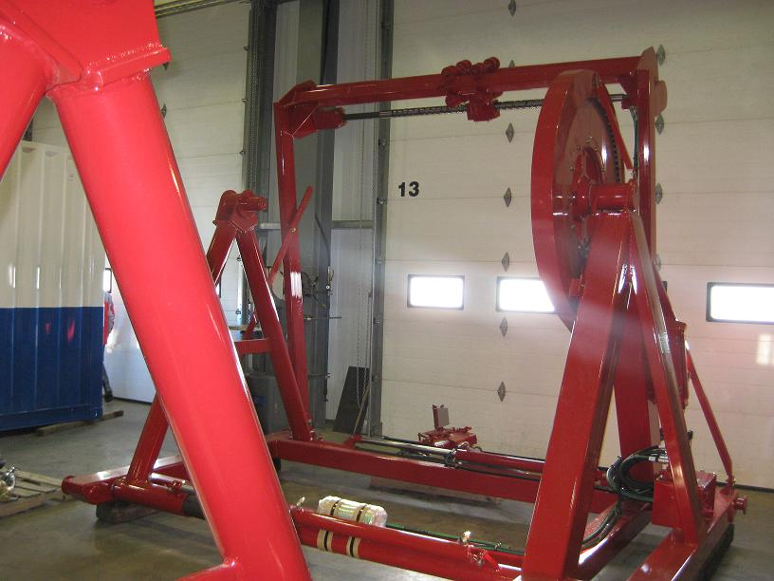
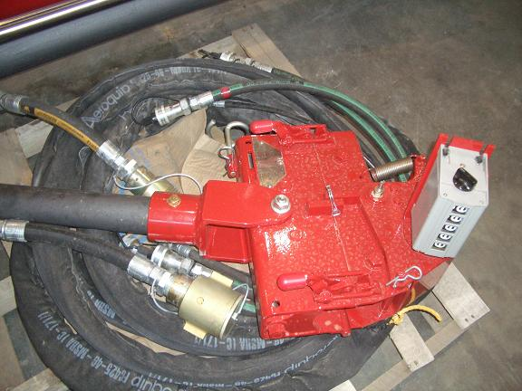
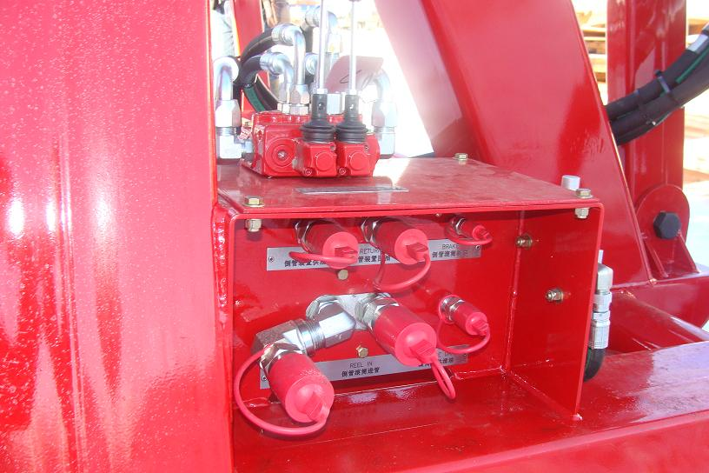
1. Preparation in Base
(1) Yard Spooling Stand

Slide 8
1. Preparation in Base
(2) Crossover for Quick Connection
Rear Deck Panel
Injector Main Power Line

Slide 9
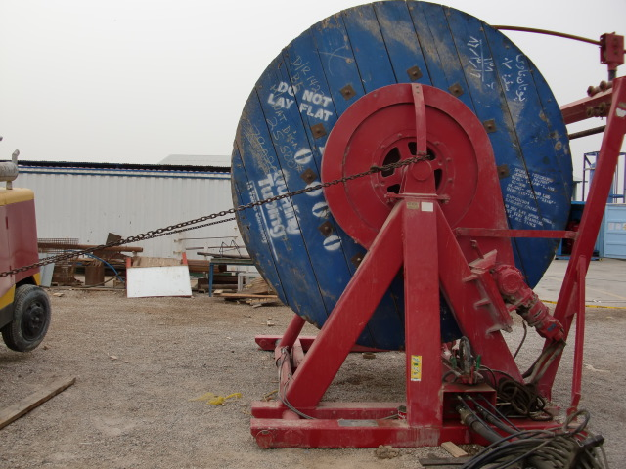
1. Preparation in Base
(3) Auxiliary Equipment and Tools
Steel Chain
Empty Reel

Slide 10
How to Change Coiled Tubing
1. Preparation in Base
2. Rig Down Old CT from The Reel
3. Rig up New CT to The Reel

Slide 11
2. Rig Down Old CT from The Reel
(1) Connect hydraulic line to yard spooling stand
(2) Install empty reel to yard spooling stand
(3) Connect CT to empty reel
(4) Rig Down Old CT from The Main Truck Reel

Slide 12
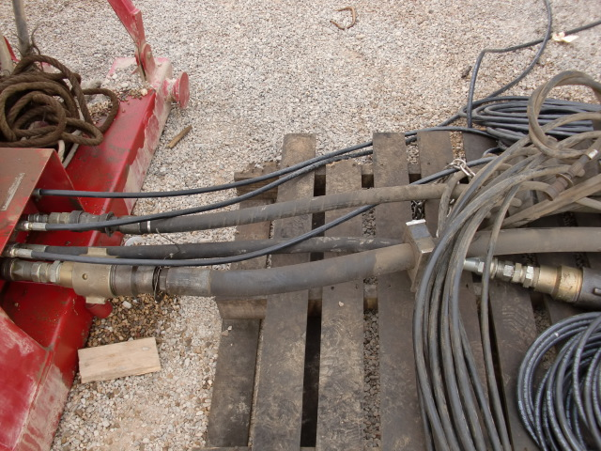
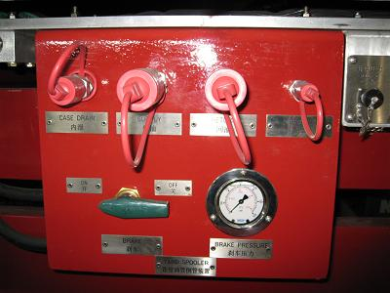
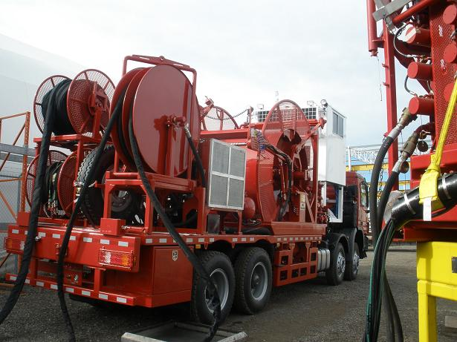
2. Rig Down Old CT from The Reel
(1) Connect hydraulic line to yard spooling stand
Rear Deck Panel
Injector Main Power Line

Slide 13
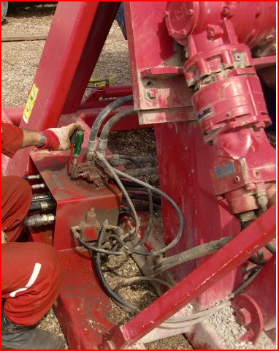
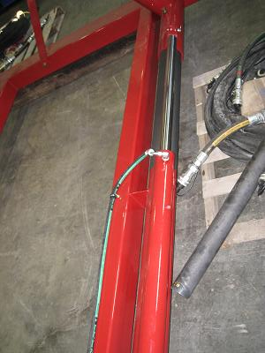
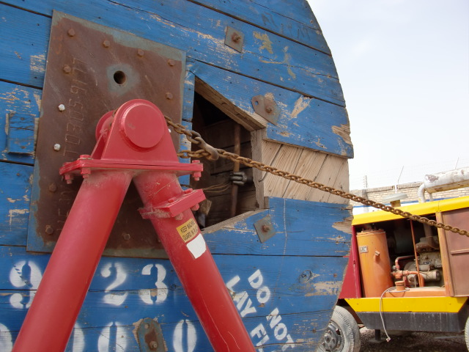
2. Rig Down Old CT from The Reel
(2) Install empty reel to yard spooling stand
Fix stand with steel chain
Adjust stand to hold empty reel

Slide 14
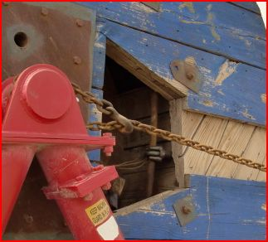
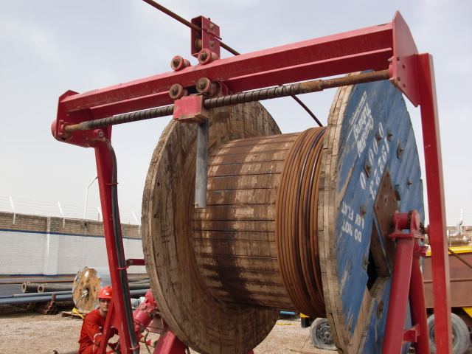
2. Rig Down Old CT from The Reel
(3) Connect CT to empty reel
Install the depth counter
Fix CT head with shackle

Slide 15
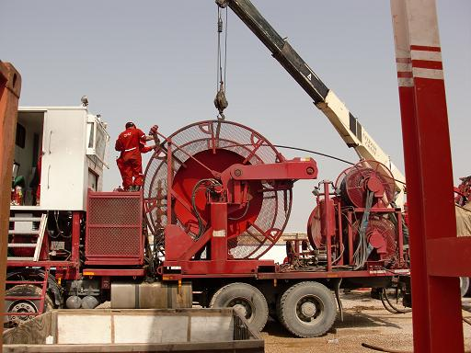
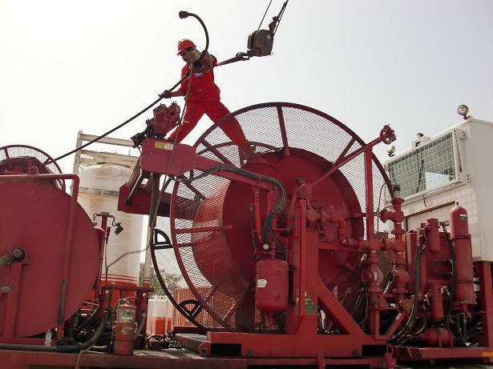
2. Rig Down Old CT from The Reel
(4) Rig Down Old CT from The Main Truck Reel
Hold with crane

Slide 16
How to Change Coiled Tubing
1. Preparation in Base
2. Rig Down Old CT from The Reel
3. Rig up New CT to The Reel

Slide 17
3. Rig Up New CT to The Main Truck Reel
(1) Install new CT reel to yard spooling stand
(2) Connect new CT to the main truck reel
(3) Rig up new CT to The main truck reel

Slide 18
3. Rig Up New CT to The Reel
Hold with crane

Slide 19
How To Change CT
NOTE:
(1) Safety
(2) Operation

Slide 20

How To Change CTU
QUESTIONS?
Thank You !
GWDC Well Testing Company

